Slide 1
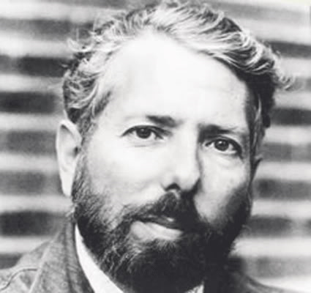
Milgram’s Original study
65% of participants continued to give shocks up to 450 volts!

Slide 2
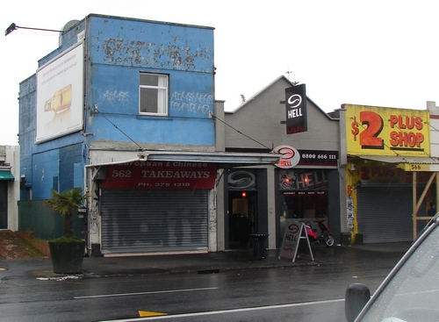
Change of Venue
Experiment moved from prestigious Yale university to rundown office in nearby town

Slide 3
LOWER
47.5%

Slide 4
Increased Proximity
Teacher and learner in same room

Slide 5
Lower
40%

Slide 6
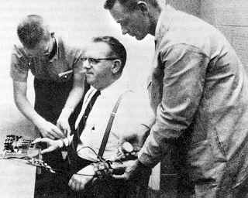
Touch Proximity- Physical Force
Teacher had to force learner’s hand onto the plate to receive electric shock

Slide 7
Lower
30%

Slide 8
Remote Authority
Experimenter left the room and gave instructions to ‘teacher’ by telephone

Slide 9
Lower
20%

Slide 10
Support
Teacher given support from two other ‘teachers’ (who were actually confederates) who refuse to obey

Slide 11
Lower
10%

Slide 12
Getting someone else to do it!
Teacher paired with confederate who administered the electric shocks to the ‘learner’.

Slide 13
Higher
92.5%

