Slide 1
Obedience to Authority

Slide 2
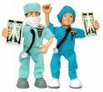
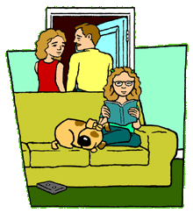
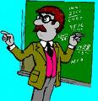
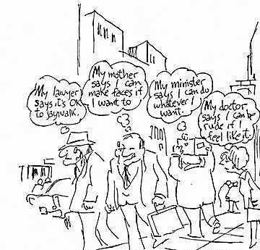
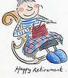
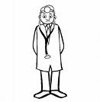
Class Discussion
What is obedience?
Who do you obey?
Why?

Slide 3
Obedience
Type of social influence whereby someone acts in response to a direct order from a perceived figure of authority.
**There is also the implication that the person receiving the order is made to respond in a way that he or she would not otherwise have done**

Slide 4
Milgram – A01
A – To test the ‘German’s are different’ hypothesis
P - Yale University
Volunteer sample
40 Male participants
Used a confederate & fixed the ‘selection’ of roles so the participant was always the teacher
Administering an electric shocks is pretty unreasonable!!
-He wanted to see how far the participants would go in order to comply with an unreasonable order from an authority figure

Slide 5
Procedure continued... – A01
Teacher-learner situation
Teacher instructed to ask questions on a memory task and punish the learner for incorrect responses
Punishment was electric shock that increased at each incorrect answer in 15v
15v (‘slight shock’) – 450v (‘XXX’) – more than enough to kill someone

Slide 6
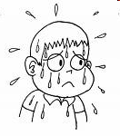
Findings - A01
Many participants showed signs of extreme tension (shaking, sweating & stuttering)
Many participants argued with the experimenter
All participants delivered shocks up to 300v
65% continued to 450v (maximum voltage)
It was estimated (before the research took place)
that most participants
would stop at 100v

Slide 7
Conclusions – A01
Milgram was able to conclude that Germans are not different and in fact
we are all capable of blind obedience to unjust orders
Remember though that 35% of participants resisted authority

Slide 8
Evaluation – A02
You should be able to think of at least 4 evaluation points without anymore information than the research outline
Low population validity
Low ecological validity
Lack of informed consent
Lack of protection of participants

Slide 9
Evaluation – A02
Hofling (1966)
Conducted research in a hospital where nurses were telephoned by ‘Dr Smith’ and asked to administer a drug to a patient (breaking several hospital rules)
21 out of 22 !!
This means that field experiments have demonstrated that individual will obey commands from an authority figure
A strength because it shows that obedience to authority figures does occur in real-life settings
3. The dosage instructed for the Nurse to administer was twice that as advised on the bottle!
1. Nurses were not supposed to take instructions over the phone
2. Nurses were not to take instructions from an unknown doctor
How many nurses obeyed Dr Smith?

Slide 10
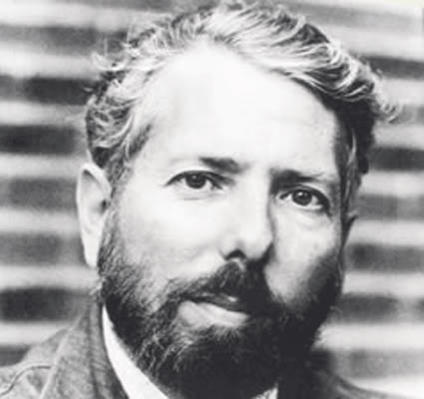
Milgram’s Original study
65% of participants continued to give shocks up to 450 volts!

Slide 11
Change of Venue
Experiment moved from prestigious Yale university to rundown office in nearby town

Slide 12
Higher or Lower??
Will obedience levels increase or decrease?
Estimate the percentage of participants you think went to 450v in this variation.

Slide 13
LOWER
47.5%

Slide 14
Increased Proximity
Teacher and learner
in same room

Slide 15
Higher or Lower??
Will obedience levels increase or decrease?
Estimate the percentage of participants you think went to 450v in this variation.

Slide 16
Lower
40%

Slide 17
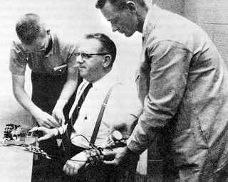
Touch Proximity- Physical Force
Teacher had to force learner’s hand onto the plate to receive electric shock

Slide 18
Higher or Lower??
Will obedience levels increase or decrease?
Estimate the percentage of participants you think went to 450v in this variation.

Slide 19
Lower
30%

Slide 20
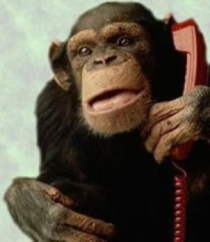
Remote Authority
Experimenter left the room and gave instructions to ‘teacher’ by telephone

Slide 21
Higher or Lower??
Will obedience levels increase or decrease?
Estimate the percentage of participants you think went to 450v in this variation.

Slide 22
Lower
20%

Slide 23
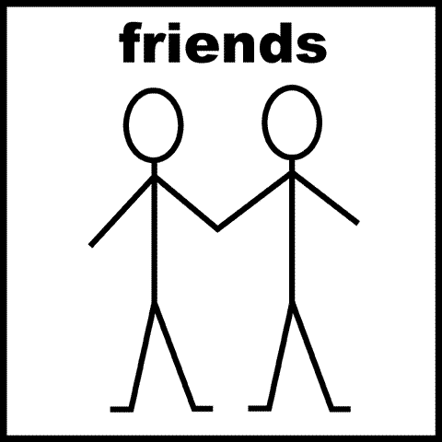
Support
Teacher given support from two other ‘teachers’ (who were actually confederates) who refuse to obey

Slide 24
Higher or Lower??
Will obedience levels increase or decrease?
Estimate the percentage of participants you think went to 450v in this variation.

Slide 25
Lower
10%

Slide 26
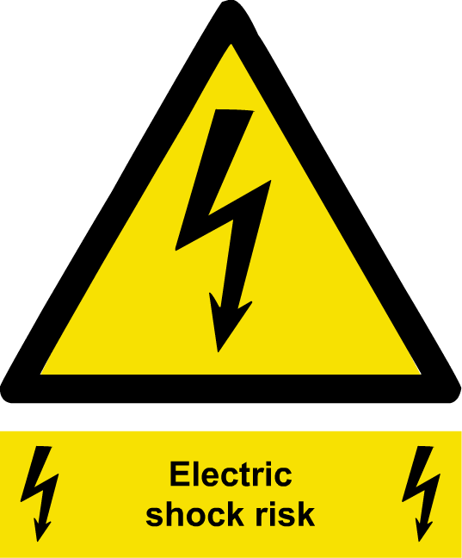
Getting someone else to do it!
Teacher paired with confederate who administered the electric shocks to the ‘learner’.

Slide 27
Higher or Lower??
Will obedience levels increase or decrease?
Estimate the percentage of participants you think went to 450v in this variation.

Slide 28
Higher
92.5%

