Slide 1
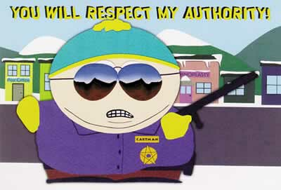
Obedience to Authority

Slide 2
Lesson Objectives
What will we cover today?
By the end of the lesson you will be able to...
Define the term ‘obedience.’
Outline research into obedience (Milgram, 1963)
Discuss some evaluation points (strengths and weaknesses) surrounding Milgram’s study (we will look in more detail at this next lesson).

Slide 3
In pairs...
Have a go at defining what is meant by the term ‘obedience’. Write your definition on your post-it note.

Slide 4
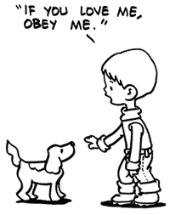
What is Obedience??
A type of social influence whereby someone acts in response to a direct order from a perceived figure of authority. There is also the implication that the person receiving the order is made to respond in a way that he or she would not otherwise have done.
(Page 16 of booklet)

Slide 5
Who do we usually obey?
Reasonable requests (e.g. You must do your homework)
Blind obedience – have a look at the pictures in the middle of your table.

Slide 6
Obedience throughout History

Slide 7
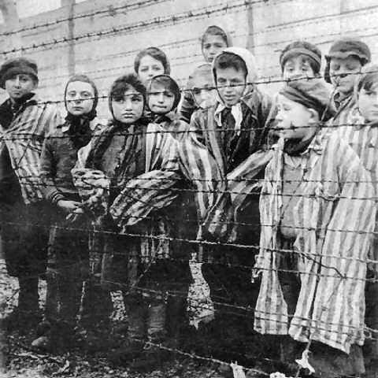
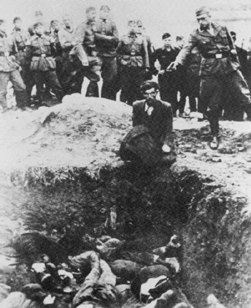
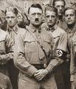
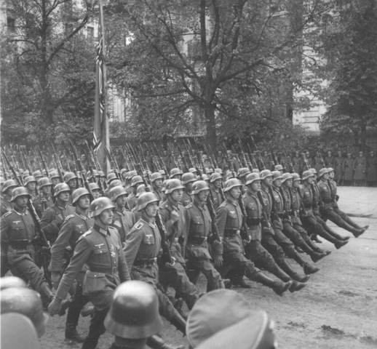
During World War II, millions of Jews, Poles, Russians, Gypsies and Homosexuals were slaughtered by Nazi soldiers. When the soldiers were tried for their war crimes their defense was “I was just following orders”.
Does this mean that Nazi soldiers are evil?

Slide 8
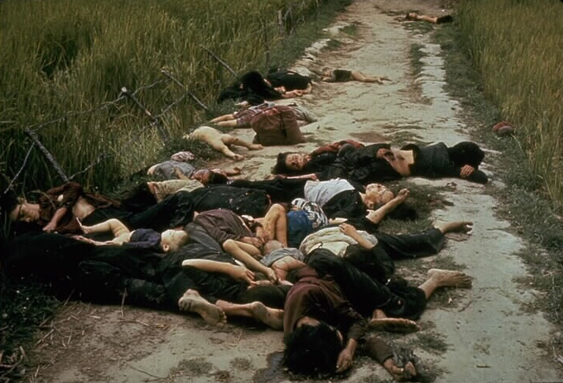
My Lai Massacre On March 16 1968, in the village of My Lai, Southern Vietnam, a group of American soldiers were told ‘This is what you’ve been waiting for – search and destroy – and you’ve got it’. The soldiers were ordered to enter into the village firing even though there had been no report of opposing fire. The soldiers slaughtered over 500 unarmed men, women and children. The soldiers had not encountered a single enemy soldier.

Slide 9
The Jonestown Massacre In 1978, in the middle of the Guyanese jungle, the Reverend Jim Jones ordered 911 members of his cult to kill themselves by drinking a cyanide potion, and they did.
The vat containing Jones' deadly concoction sits amid the bodies of his followers on Nov. 20, 1978.

Slide 10
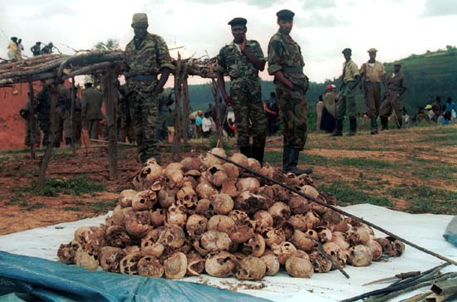
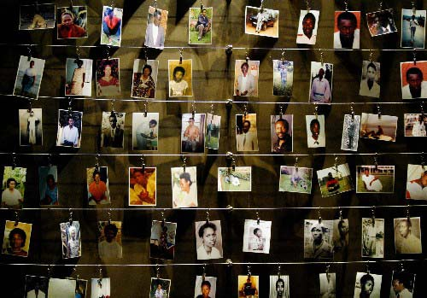
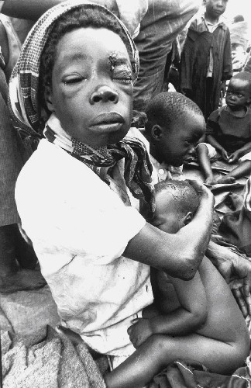
April 7th 1994 – Rwanda - Genocide
The slaughter of 800,000
The genocide was a deliberate conspiratorial operation organised by a small, shrewd group of greedy Hutu extremists who believed their self-interest would be enhanced if every one of Rwanda's 1 million Tutsis was annihilated. They came close to total success.

Slide 11
OBEDIENCE
As human beings......we have a responsibility to make sure that we learn from the mistakes of the past....
We have a responsibility to make sure that we learn from Social influence research into Obedience....
What have we learnt? ......................
Why do people obey?
Discuss ...........

Slide 12

Milgram's Experiment (1963)
Influential study testing ‘are the Germans different’ hypothesis.
Carried out at Yale University (a prestigious setting).
40 male participants (volunteer sample)
Confederate (fake participant) – learner
Participant (genuine) - teacher

Slide 13

Shock Machine!!
15v – Slight Shock
Increases in 15v increments
Domestic supply 230 volts
450v - XXX

Slide 14

Findings…
Participants showed signs of extreme stress and tension – shaking and sweating
Many participants repeatedly argued with the experimenter – all participants continued to deliver shocks up to 300v
Staggering 65% continued to 450v
Predictions prior to the experiment – most would stop at 100v

Slide 15

Conclusion
Milgram was therefore able to conclude that Germans are not different and in fact we are all capable of blind obedience.

Slide 16
How can I use this information in the exam?
Outline and evaluate research into obedience. (12 marks)
Or...
Outline research into obedience.
(6 marks)

Slide 17
Film Strip Activity
You have been given a film strip and some iconic photographs from Milgram’s study.
Individually, produce a picture film strip illustrating the key points of Milgram’s procedure.
As well as sticking the pictures in the correct order you should also add in captions to help you remember key information (you may not need to use all the pictures provided).

Slide 18
Plenary – Reflecting on the lesson
What have you learned in the lesson today?
What knowledge did you already have before the lesson that has helped you to understand the work that has been covered?
Do you have any questions on the content covered in the lesson?
Complete the learning review sheet to assess your learning.

Slide 19
Homework
Stretch and Challenge activity...
  Read the extension material at the back of your booklet on Milgram’s experiment (page 29)
  Check your email – links for three you tube clips on a recent Milgram replication (yes, the same level of obedience still exists today)!

Slide 20
Lesson Objectives
What will we cover today?
By the end of the lesson you will be able to...
Discuss evaluation points (strengths and weaknesses) surrounding Milgram’s study.
Discuss whether or not the findings and knowledge gained from Milgram’s study outweighed the costs.

Slide 21

Recap of Milgram’s study
Read through the description of Milgram’s study – identify and correct the mistakes.
First person to finish (with all the correct answers) wins a prize!

Slide 22

The Real Milgram Experiment
Watch the video of the real Milgram experiment.
Focus on how the participants act in the study?
What types of behaviour are they demonstrating?
How could this study impact on their lives after the experiment?

Slide 23
Evaluation
What do you think?
After watching the video of Milgram’s study, can you think of any strengths/weaknesses?
When evaluating you should think about;
  Methodological Issues
  Ethical Issues
  Previous research that supports/goes against the original findings

Slide 24

Evaluation
On your post-it note, write down one point that could be used to evaluate Milgram’s study.
Stick your post-it on the board when you have finished (be prepared to explain your point to the rest of the class).

Slide 25

Milgram on trial...
Do the findings and knowledge gained from Milgram’s research outweigh the costs?
Milgram broke ethical guidelines.
His study can be questioned in terms of validity (including internal – did the participants know the shocks were fake?)

Slide 26

Letter to Milgram
You are going to be split into two teams;
  Team Defence
  (you will argue that Milgram’s study was worth while through the fact that we have gained a lot of knowledge from his research).
  Team Prosecution
  (you will argue that Milgram’s study should have never taken place due to the fact that it goes against the ethical guidelines and that it may not actually be measuring true obedience).

Slide 27


Let the trial begin...

Slide 28


Evaluation
Hofling (1966) found 95% obedience to authority.
Laboratory experiment, therefore the study lacks ecological validity because...
Artificial setting therefore the study lacks mundane realism...
Ethical issues – the study used deception.

