Slide 1


Biological Explanation of Obsessive Compulsive Disorder (OCD)
Abnormalities are caused by physical problems in the brain or body!

Slide 2
OCD - Characteristics
OCD is an anxiety disorder where sufferers experience persistent and intrusive thoughts occurring as obsessions, compulsions or a combination of the two.
Obsessions
Internal
The things that people think about
Forbidden and intrusive ideas and visual images
Not based in reality
Compulsions
External
What people do as a result of the obsessions
Comprise of intense, uncontrollable urges to repetitively perform tasks and behaviours

Slide 3
OCD - Characteristics
Behavioural
Hinder everyday functioning
Social impairment
Repetitive behaviour
Emotional
Extreme anxiety
Distress
Cognitive
Recurrent and persistent thoughts
Recognised as self-perpetuating
Realisation of inappropriate
Attentional bias
Uncontrollable urges

Slide 4
What Biological Psychologists believe...
Abnormalities – physical problems.
Brain/body.
Mental illnesses diagnosed in same way as physical illnesses.
Approach favoured by medicine/psychiatry (specialists in mental disorders).

Slide 5
What physical problems in the body could cause an abnormality???

Slide 6
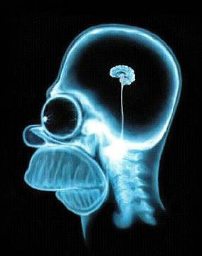

Key features of the biological approach to psychopathology...
It’s all the brain’s fault - Brain Differences
Don’t blame it on the boogie, blame it on the brain.
Changes in the structure (size)
Changes in the activity (neurotransmitters/hormones/biochemicals)
May be too much or too little of a neurotransmitter/hormone.
Can affect mood and behaviour (mental illness)

Slide 7

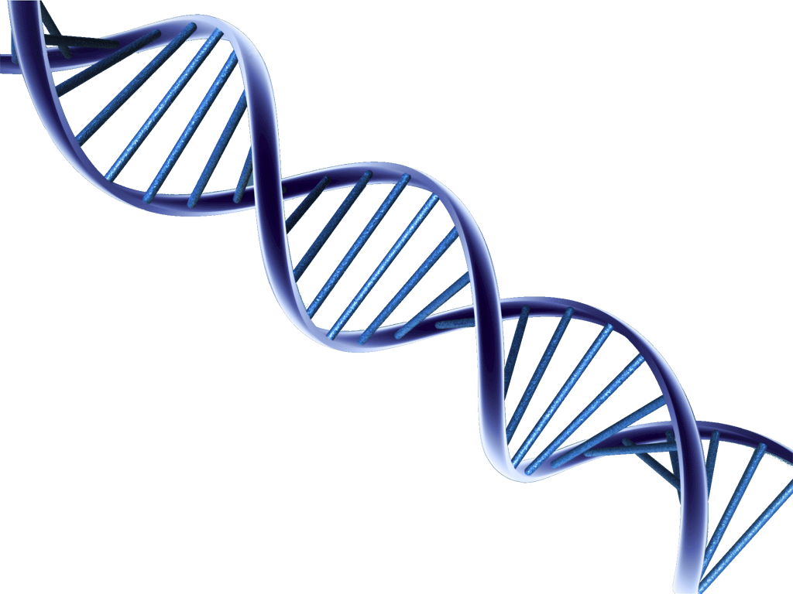
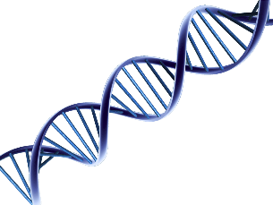
Genetic Explanations
The SERT gene:
  Also called 5-HTT is thought to affect the transport of serotonin (creating lower levels of the neurotransmitter)
  These changes in serotonin are also implicated in OCD
It’s all in your Genes!
A popular explanation for this disorder is that it was inherited (specific genes are passed on from biological parents).
Two types of genes: COMT and SERT!
The COMT:
  Gene maybe involved in the onset of OCD
  Called the COMT because it involved the production of catechol-O-methyltransferase
  COMT regulates the production of the neurotransmitter dopamine
  All genes are different but one form of the COMT gene has been found to be more common in individuals with OCD (Tukel et al, 2013)
  This form of the COMT gene produces lower activity of the gene and higher levels of dopamine.
Diathesis-Stress Model? (genotype+phenotype)
Can our behaviour simply be a product of genetics?
Many psychologists state that we have a genetic vulnerability to have an abnormality (i.e. we may have the SERT gene or a type of COMT gene) however, an abnormality will not necessary develop with just this gene alone.
Interactions with our environment are also important (i.e. the amount of stress that we suffer, the behaviours that we witness, healthy diet, alcohol etc…)

Slide 8

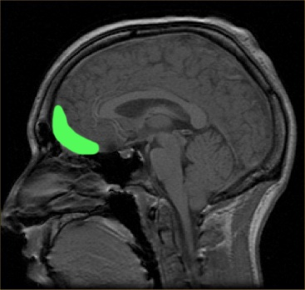
Neural Explanations
Abnormal Levels of Neurotransmitters:
High Dopamine:
  Szechtman, 1998 conducted animal studies and found that high doses of drugs that enhance levels of dopamine induced movements the represented OCD
Low Serotonin:
  Is associated with OCD
  Pigott, 1990 found that anti-depressant drugs (which increase serotonin activity) have been shown to reduce symptoms of OCD
Increased Activity in the Brain (Obofrontal Cortex):
Activity witnessed on the PET scans of OCD sufferers
This part of the brain helps to initiate activity upon receiving impulses to act and then stop the activity when the impulses lessen.
E.g. a non-sufferer may have the impulse to wash dirt from their hands, once this action is complete, the impulse stops. This is not always the case for a sufferer of OCD.

Slide 9
Evaluation of Biological Explanations
Research to support the biological explanation of OCD
Billett et al (1998), using a meta-analysis of 14 twin studies of OCD found that, on average, identical twins are twice as likely to develop OCD if their co-twin had the disorder, the chances of developing OCD was lower for the co-twin of non identical twins.
This is a strength because indication that genetics do play a part in OCD
The biological explanation of OCD can be criticised as being deterministic
The biological approach states that if an individual has the presence of the COMT or SERT gene then they will go on a develop OCD (they will be pre-programmed to have this disorder).
This is a weakness because the biological approach ignores individual free will (free choice can influence their behaviour).
The biological explanation of OCD can be criticised as being reductionist
The biological explanation suggests that OCD is caused by the presence of the SERT or COMT gene or by lower levels of serotonin in the brain, it states that OCD is a product of just an individuals nature.
This is a weakness because this approach ignores the role of nurture (up bringing/everyday stressors etc…)

Slide 10

Therapies based on the Biological Approach

Slide 11
What can you remember about the Biological Approach?
Physical cause
Brain Differences –
Structure (e.g. size)
Function (e.g. biochemical balance)
Genetics – Genetic component - inherited
Passed through family lines
Uses twin studies to investigate

Slide 12

How would the Biological Approach treat OCD?
Drug Treatments:
  Anti-depressants (selective serotonin reuptake inhibitors) aim to increase serotonin in the brain
  Anti-anxiety drugs (benzodiazepines) aim to reduce the anxiety associated with OCD

Slide 13

Over to you...
In your groups have a go at the sorting activity and sort the labels into the two types of drugs – anti depressants
- anti anxiety drugs
Remember to think about;
- How the drugs are used
- How they work
-The side effects

Slide 14
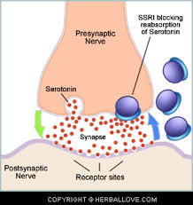
Anti-Depressants
What are they used for?
  To treat depression (mainly)
  To treat OCD
  How do they work?
    Raise levels of serotonin in the brain (low levels of serotonin are linked to OCD symptoms
    Prozac reduces the rate of re-absorption of serotonin (serotonin levels don’t drop, mood remains constant).
    Prozac can be a long term treatment (also used to treat OCD)
    Are there any side effects?
      Nausea,
      Insomnia
      Sexual dysfunction
      Suicidal morbidity

Slide 15


Slide 16
Anti-anxiety drugs
What are they used for?
  Range of anxiety disorders (phobias, panic attacks and sleep disorders)
  OCD
  How do they work?
    GABA has a natural ‘quietening’ effect on neurons in the brain – OCD sufferers experiences lots of anxiety
    GABA locks into the receptor sites of the brain, increasing the flow of chloride ions into the neuron (slows down brain activity)
    Acts as a sedative that decreases heart and respiration rate (reduce tension and nervousness)
    Calming effect
    Are there any side effects?
  Dependency (addiction)
  Drowsiness and lethargy
  Toxic – overdose can lead to death

Slide 17
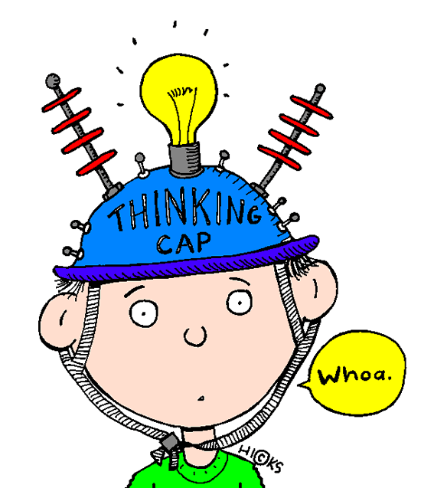
Are drugs an effective treatment?
What do you think?
  Very effective treatment
  Usually quick acting (compared to other therapies)
Soomro et al (2008) reviewed 17 studies of the use of SSRIs with OCD patients
Found the SSRIs to be more effective than placebos (after three months of receiving treatment)
What does this mean?
Effective Treatment!

Slide 18

Are drugs an effective treatment?
What do you think?
Negative/potentially harmful side effects.
  Prozac (AD) Nausea, insomnia, suicidal morbidity –patients should be made aware
  Weakness – safety of such drugs should be questioned!!
  Drug treatments often treat the symptoms but do not cure the disorder
    For example, many patients report a significant decrease in their symptoms of OCD (report having less obsessions and compulsions, feel that they are able to cope more with everyday life. Yet, when patients stop the drug treatments the symptoms often return.
    This is a weakness because, the drug treatments can be seen to only mask the negative symptoms of OCD, in the short term they are good at giving patients a break from the symptoms yet, in the long term a more appropriate treatment to remove the OCD completely is needed.

