Slide 1
Psychopathology – what do I need to know?
Behavioural Explanation of Phobias (Two-Process Model, Classical and Operant Conditioning)
Biological Explanation of OCD (The Genetic and Neural Explanations)
Cognitive Explanation of Depression (Beck’s Negative Triad, Ellis’ ABC Model)
In addition, you need to know the emotional, behavioural and cognitive characteristics of phobias, OCD and depression
Behavioural – physical actions that individuals with such abnormalities display
Emotional – the feelings that individuals (suffering from such abnormalities) hold
Cognitive – thoughts held by individuals suffering from such disorders

Slide 2

The Behavioural Approach to Psychopathology
LEARN!!

Slide 3
Lesson Objectives
By the end of the lesson you will be able to...
Describe the Two-Process Model explaining phobias
Describe how phobias are initiated (how they start)
Describe how phobias are maintained (why they continue)
4. Evaluate the Behavioural Approach as an explanation of phobias (if time permits).

Slide 4


The Behavioural Approach
Behavioural Psychologists believe that...
All behaviour, both normal and abnormal, is learnt.
Abnormality is a learnt response to some environmental stimuli.
Behaviourists believe psychology should be the study of observable behaviours rather than the inner workings of the mind.
Observable behaviours provide a foundation for scientific psychology based on empirical evidence.
Page 11 of booklet

Slide 5

Key Features of the Behavioural Approach
According to behaviourists, there are three main forms of learning...
Classical Conditioning
(2) Operant Conditioning
(3) Social Learning Theory

Slide 6
Developing a Phobia
There are two parts to developing a phobia:
How a phobia is initiated (how it begins/where it comes from)
How the phobia is maintained (why the phobia continues to exist
As a result of this, the Behavioural Model that we are going to focus on is the Two-Process Model which explains both how a phobia is initiated and maintained.

Slide 7

Classical Conditioning – What can you remember? An Explanation of Phobia Initiation
Produces
Before Conditioning
During
Conditioning-
over many trials
Produces
After
Conditioning
https://www.youtube.com/watch?v=OwBQIhg6CvE

Slide 8

Link to a Disorder
Can you think of how classical conditioning might play a part in the development of mental disorders?
Phobias
‘Little Albert,’ Watson and Rayner (1920) complete the booklet p.14
Now, have a go at applying classical conditioning to the development of phobias.
Application Activity
http://www.youtube.com/watch?v=KxKfpKQzow8 / video of little Albert (Staff share)

Slide 9
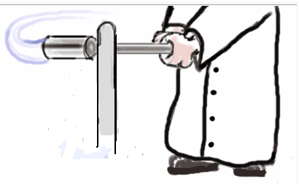

The Behavioural Approach to Psychopathology: Classical Conditioning.
Little Albert, Developing a Phobia.
Unconditioned Stimulus
Unconditioned Response
Unconditioned Stimulus
Neutral Stimulus
Unconditioned Response
Conditioned Stimulus
Conditioned Response

Slide 10


Operant Conditioning
Have you noticed anything taking place in class today?
Your class contributions have been being rewarded (with skittles)

Slide 11
Operant Conditioning – An Explanation of why phobias are maintained
Operant conditioning is learning through reinforcement (e.g., rewards) and punishment.
Sound too simple?
Skinner (1974) was able to show how quite complex patterns of behaviour could develop as a result of using reinforcement

Slide 12

Operant Conditioning
Reinforcement (both positive and negative) –
strengthens (encourages) behaviour
In terms of abnormality, abnormal behaviour
is learnt when maladaptive behaviour is
Positively/negatively reinforced
Once a phobia has been acquired (through classical conditioning) individuals then exhibit avoidance responses (e.g. an individual with a phobia of dogs may avoid coming into contact with dogs)
This avoidance reduces of chances of the individual having to face the fearful situation which reduces fear and anxiety – what type of reinforcement is this?
This decrease in anxiety makes an individual happy and therefore they are likely to adopt this avoidant response in the future.

Slide 13
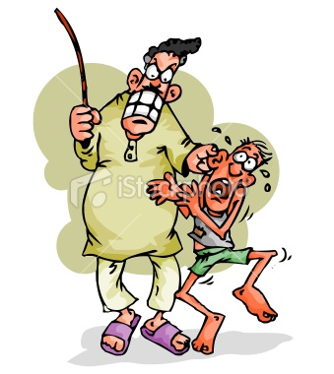
Operant Conditioning
Application of this theory to Little Albert…
Albert would avoid all situations where there would be a risk of him coming into contact with white fluffy animals/objects.

Slide 14

Evaluation (AO2) Strengths
The behavioural approach to psychopathology is scientific.
For example, the phobias developed by little Albert could be observed and measured (there was empirical evidence that he had developed these phobias as a result of a learned response).
This means that the approach focuses on observable and measurable behaviour.
This is positive because it allows concepts such as classical conditioning to be demonstrated scientifically and has resulted in a large amount of empirical support for behavioural therapies.

Slide 15

Evaluation (AO2) Weakness
The behavioural approach to psychopathology is deterministic.
For example, rewards and punishments in operant conditioning might determine whether we develop abnormal behaviours.
This means that the approach suggests that our behaviour is ruled by environmental factors outside of our control (e.g. Parents).
This is problematic because it ignores human characteristics of free will.
Example?

Slide 16
Evaluation (AO2) Weakness
The behavioural approach to psychopathology is reductionist.
For example, it suggests that complex mental disorders are caused solely by our experience of reward and punishment.
This means that the approach reduces complex behaviours down to its most basic elements or parts.
This is problematic because it ignores the role of the biology, our experiences in childhood and the stressors within our lives and, as a result, the behavioural approach to psychopathology may be too simplistic.

Slide 17
Lesson Objectives
By the end of the lesson you will be able to...
Describe the Two-Process Model explaining phobias
Describe how phobias are initiated (how they start)
Describe how phobias are maintained (why they continue)
4. Evaluate the Behavioural Approach as an explanation of phobias (if time permits).

Slide 18
Initiating Phobias with Classical Conditioning – What can you remember?
Produces
Before Conditioning
During
Conditioning-
over many trials
Produces
After
Conditioning

Slide 19
Initiating Phobias with Classical Conditioning – What can you remember? Application Activity
Produces
Before Conditioning
During
Conditioning-
over many trials
Produces
After
Conditioning

Slide 20

Behavioral Treatments
Systematic Desensitisation

Slide 21
Quick recap of the Behavioural Explanation (Phobias)
Abnormal behaviour is learnt in exactly the same way as ‘normal’ behaviour.
Through Classical or/and Operant conditioning (Two-Process Model)
The case of Little Albert (Watson and Raynor, 1920) demonstrates how a phobia can be learnt through classical conditioning.

Slide 22
Little Albert’s response later generalised to rabbits, dogs, cotton wool, Watson’s hair and a Santa mask.
It took one week to condition little Albert.
Classical conditioning can also be used to remove a phobia through a treatment called systematic desensitisation.

Slide 23
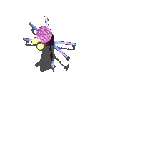
Behavioural Therapy – Systematic Desensitisation
For example (Desensitisation):
A person who has a severe spider phobia will have previously learned to feel afraid when a spider is present.
To overcome this fear, the therapist needs to systematically teach the person a new response to the spider (not afraid).
The client is taken through a process where they are taught to relax when the spider is present (deep muscle relaxation).
This causes the client to become ‘desensitised’ to spiders.
Used to treat...
Phobias
OCD
How it works...
Based on classical conditioning (change maladaptive behaviour (previously learned) to an adaptive behaviour.
Counter-conditioning (reverse learning) replace fear with a harmless response.
Systematic desensitisation (SD) treats abnormalities step by step.
Key concept of SD is reciprocal inhibition (impossible to feel to opposite emotions at the same time, e.g. Fear and relaxation)

Slide 24
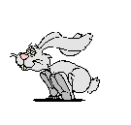
An Early Example...
Little Peter (Jones, 1924)
Two year old with an extreme fear of rabbits.
Jones (supervised by Watson) put a rabbit in a wire cage in front of Peter while he ate his lunch.
Over a series of sessions, Jones gradually moved the rabbit closer to Peter.
It took 17 steps to break down Peter’s fear.
By the end of the treatment, Peter ate his lunch with one hand and stroked the rabbit with the other.
This is an early example of systematic desensitisation.

Slide 25

How Systematic Desensitisation is used...
Uses a hierarchy of increasingly fearful situations (climb up hierarchy)
Client taught deep relaxation techniques (create an alternative harmless response to replace the fear).

Slide 26



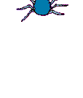


Most fearful
Situation 5
Holding
a spider
Situation 4
Sitting near a spider
Situation 3
Looking at a spider in a jar
Situation 2
Watching a video of a spider
Situation 1
Looking at a picture of a spider
Least fearful

Slide 27
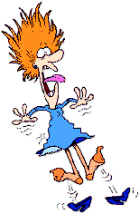

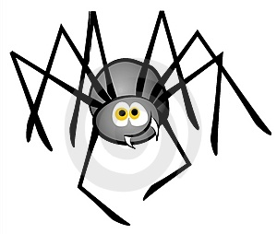
The aim of systematic desensitisation is that eventually the client will be able to associate the most fearful situation at the top of the hierarchy with a relaxed response.
From this.... To this...

Slide 28
Wolpe (1958) proposed clients with phobias should be taken through the following steps...
Deep muscle relaxation training
Construct a hierarchy
Start at the bottom of hierarchy and work upwards
If the patients feels anxiety, image is stopped and relaxed status is regained

Slide 29
A Second Behavioural Therapy - Flooding
Operates under the idea of Counter-Conditioning (like SD)
Moves away from the hierarchical approach of SD
Individuals move straight away to the step at the top of the hierarchy (have direct contact with their most feared scenario)
Works on the assumption that individuals cannot make their usual avoidance response, anxiety peaks at such high levels and cannot be maintained, eventually anxiety subsides

Slide 30
Evaluation of Behavioural Therapies
Can you think of any strengths/weaknesses?
Lets have a go at perfecting your AO3 skills for the exam!

Slide 31
+ Systematic desensitisation can be a very effective treatment.
How do you know? Where’s your evidence?
+ Barlow et al (2002) found success rates of between 60 and 90% for specific types of phobias.
But why is this a strength? How does it support that the treatment is successful?
+This is positive because this therapy is effective at removing the symptoms of a disorder without the need for potentially damaging drugs (e.g. Anti-anxiety drugs). Also, the effectiveness of SD is supported by many other research studies.

Slide 32

Can you think of any weaknesses?
Behavioural therapies raise major ethical issues.
- Clients faced with most feared situations.
- Behavioural techniques can cause clients to feel very high levels of distress.
- This is a weakness because... Clients may not stay in
therapy/ therapy could make them feel worse,
Behavioural therapies are not effective for complex phobias
- Ohman (1975) SD may not being effective in treating anxieties that have an underlying survival component (e.g. Fear of heights).
- Behavioural therapies target the learnt associations (thought to cause the behaviour) BUT ignores other potential explanations (e.g. Genetics)
This is a weakness because only focusing on the removal of symptoms and not the removal of the cause of the phobia may mean that the disorder is only temporarily removed.

Slide 33
Write a set of instructions for a Behavioral Therapist carrying out Systematic Desensitisation
Most fearful
Least fearful

