Slide 1
Attachment

Slide 2
Lesson Objectives
By the end of the lesson you will be able to...
  Define the key terms associated with Learning Theory/ Behavioural Theory of attachment.
  Outline the Behavioural Theory of attachment (Learning Theory).
  Evaluate the theory in terms of the strengths and weaknesses.
  Some students will progress on to Applying their knowledge of Learning Theory to a past exam question.

Slide 3
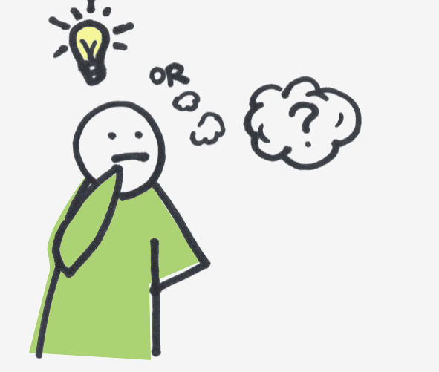

Keep on your Toes!! Key Learning Theory Definitions
Cupboard Love Theory
Blank Slate
Association
Nurture
Classical Conditioning
Unconditioned Stimulus
Unconditioned Response
Neutral Stimulus
Conditioned Stimulus
Conditioned Response
As we progress through the lesson, define these key terms (in your glossary) as and when we cover them!

Slide 4
Discussion Activity
Protection
Meet Physiological Needs
Meet Needs
Why might attachments form between infants and their primary caregivers?
Companionship
Gene Survival

Slide 5
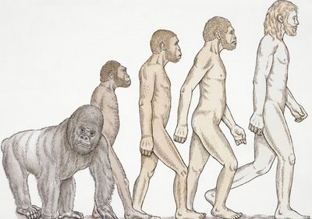
Theories of Attachment
Sort it Out!!
Learning Theory – (The Behavioural Explanation), Miller and Dollard
The Evolutionary Theory, John Bowlby

Slide 6
Learning Theory/Behavioural Theory of Attachment
Learning Theory
Evolutionary Theory of Attachment
Evolutionary Theory
Biological Explanation
Evolutionary Theory
Learning Explanation
Learning Theory
Nature (behaviours are a product of our biology)
Evolutionary Theory
Nurture (behaviours determined by environment/upbringing/experiences
Learning Theory
Develop attachment through association/classical conditioning
Learning Theory
Individuals have a gene that motivates attachments to form
Evolutionary Theory
Food is important in attachment formation – infants learn to associate their primary caregiver as the provider of food
Learning Theory
Caregivers are genetically programmed to form attachments with their offspring
Evolutionary Theory

Slide 7
Attachments form in order to accommodate gene survival
Evolutionary Theory
Infants find food comforting (pleasurable) and therefore infants begin to associate their primary caregiver as a provider of comfort
Learning Theory
Infants are able to encourage the attachment formation process due to them exhibiting social releasers (features that make infants look cute/vulnerable).
Evolutionary Theory
Also referred to as the ‘Cupboard Love Theory’
Learning Theory

Slide 8
Learning Theory

Slide 9
Learning Theory
Theory often referred to as ‘cupboard love theory’ – infant learns to love the primary caregiver (usually the mother) because she meets the infants needs (food from the cupboard)
Suggests that all behaviour is learned through classical conditioning (learning a behaviour through association)
Suggests that all infants are born as ‘blank slates’ (all behaviours and skills are developed through experiences and learning)
Behaviour is learned rather than innate (behaviour is not a product of a gene or an inbuilt mechanism)

Slide 10
Key Assumptions of Learning Theory
An infant learns to associate their caregiver with their needs being met (e.g. provider of food) and so an attachment is formed, (associate – building a link between two stimuli)

Slide 11

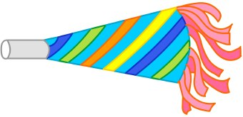
Classical Conditioning Demonstration
Volunteers please?
Volunteer one will go through the process of classical conditioning.
Volunteer two will assist the process of classical conditioning.

Slide 12

Classical Conditioning Questions
Answer the questions about the process that you have just witnessed.

Slide 13


Classical Conditioning Questions
The balloon in this study is what we call an Unconditioned Stimulus (something that creates us to respond in a way that has not been learned through our environment)
Describe what most peoples reaction to the popping of a balloon is?
________________________________________________________________________________________
This reaction is what we call an Unconditioned Response – a behaviour that we have not learned through our own experiences, most people have an innate response to jump or be frightened by loud noises such as balloons popping.
How would you describe most people’s reactions to the sound of a party hooter?
________________________________________________________________________________________
The party hooter is a Neutral Stimulus it does not naturally create any specific reaction in an individual.
What two variables were paired together in the class demonstration?
________________________________________________________________________________________
This pairing process was repeated (over and over) – explain why this was important in the process of classical conditioning?
________________________________________________________________________________________
After this process has taken place (over and over) what does the sound of the hooter (in the absence of the balloon popping) often cause an individual to do?
________________________________________________________________________________________
In this situation, the party hooter has become the Conditioned Stimulus (an object that we have learned to respond a specific way to) the Conditioned Response is our learned response to this situation (i.e. the hooter causing us to jump).

Slide 14

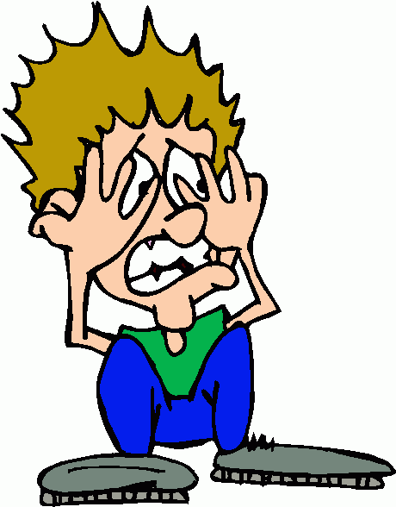



Classical Conditioning
Insert the words from the PowerPoint presentation into the classical conditioning diagram below

Slide 15
Key Words for the Classical Conditioning Schedule
Unconditioned Stimulus Neutral Stimulus
Balloon Popping Conditioned Stimulus
Fear
Unconditioned Response Party Hooter
Conditioned Response

Slide 16
Classical Conditioning Questions
The balloon in this study is what we call an Unconditioned Stimulus (something that creates us to respond in a way that has not been learned through our environment)
Describe what most peoples reaction to the popping of a balloon is?
________________________________________________________________________________________
This reaction is what we call an Unconditioned Response – a behaviour that we have not learned through our own experiences, most people have an innate response to jump or be frightened by loud noises such as balloons popping.
How would you describe most people’s reactions to the sound of a party hooter?
________________________________________________________________________________________
The party hooter is a Neutral Stimulus it does not naturally create any specific reaction in an individual.
What two variables were paired together in the class demonstration?
________________________________________________________________________________________
This pairing process was repeated (over and over) – explain why this was important in the process of classical conditioning?
________________________________________________________________________________________
After this process has taken place (over and over) what does the sound of the hooter (in the absence of the balloon popping) often cause an individual to do?
________________________________________________________________________________________
In this situation, the party hooter has become the Conditioned Stimulus (an object that we have learned to respond a specific way to) the Conditioned Response is our learned response to this situation (i.e. the hooter causing us to jump).
Fear
No real reaction
Balloon Popping and Party Hooter
It takes time (repetition) for an association to be created
Fear – causes the individual to jump

Slide 17
Classical Conditioning
Insert the words from the PowerPoint presentation into the classical conditioning diagram below
Unconditioned Stimulus
Unconditioned Response
Balloon Popping
Neutral Stimulus
Fear
Unconditioned Stimulus
Unconditioned Response
Balloon Popping
Party Hooter
Fear
Conditioned Stimulus
Conditioned Response
Party Hooter
Fear

Slide 18
Learning Theory (Classical Conditioning)
Unconditioned Stimulus
Unconditioned Response
Unconditioned Stimulus
Neutral Stimulus
Unconditioned Response
Conditioned Stimulus
Conditioned Response

Slide 19
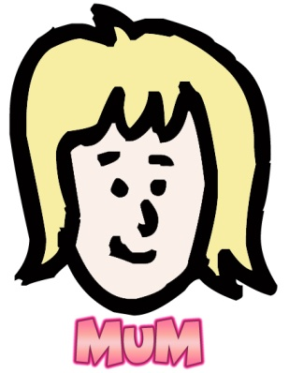
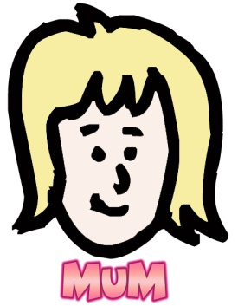
Classical Conditioning
Unconditioned Response
Unconditioned Stimulus
Neutral Stimulus
Food
Comfort
Unconditioned Stimulus
Unconditioned Response
Food
Comfort
Conditioned Stimulus
Conditioned Response
Comfort

Slide 20
The person providing this food (usually the mother) becomes associated with this pleasure and therefore becomes a conditioned stimulus
The food-giver then becomes a source of pleasure regardless of whether they provide food or not.

Slide 21
Lesson Objectives
By the end of the lesson you will be able to...
  Define the key terms associated with Learning Theory/ Behavioural Theory of attachment.
  Outline the Behavioural Theory of attachment (Learning Theory).
  Evaluate the theory in terms of the strengths and weaknesses.
  Some students will progress on to Applying their knowledge of Learning Theory to a past exam question.

Slide 22


A valid theory?
Any Suggestions?

Slide 23


Evaluation of Learning Theory
Look at the evaluation prompts on your desk.
You are going to Use this information (along with the videos presented) to evaluate (form a strength or weakness of the learning theory)
Remember to use your 3 point rule in order to evaluate effectively.

Slide 24
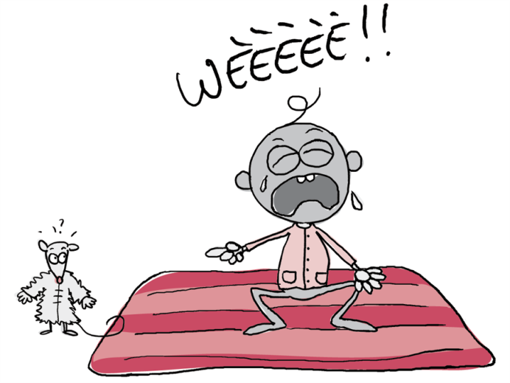
Evaluation of Learning Theory
Watson and Rayner – Little Albert: Watson and Rayner decided to investigate whether behaviours could be learned by trying to cause a phobia in an infant (Little Albert).
At the beginning of the study, Albert had no phobias in relation to white rats/fluffy animals. The sound of a loud noise (two metal poles being banged together) made him fearful and cry. Watson and Rayner paired the loud noise created by the poles with a white rat. This association was presented to Albert on repeated occasions. Eventually, in the absence of the loud noise Albert displayed fear towards the white rat.
What is this process an example of?
How can this research be used to support/ go against Learning Theory?

Slide 25
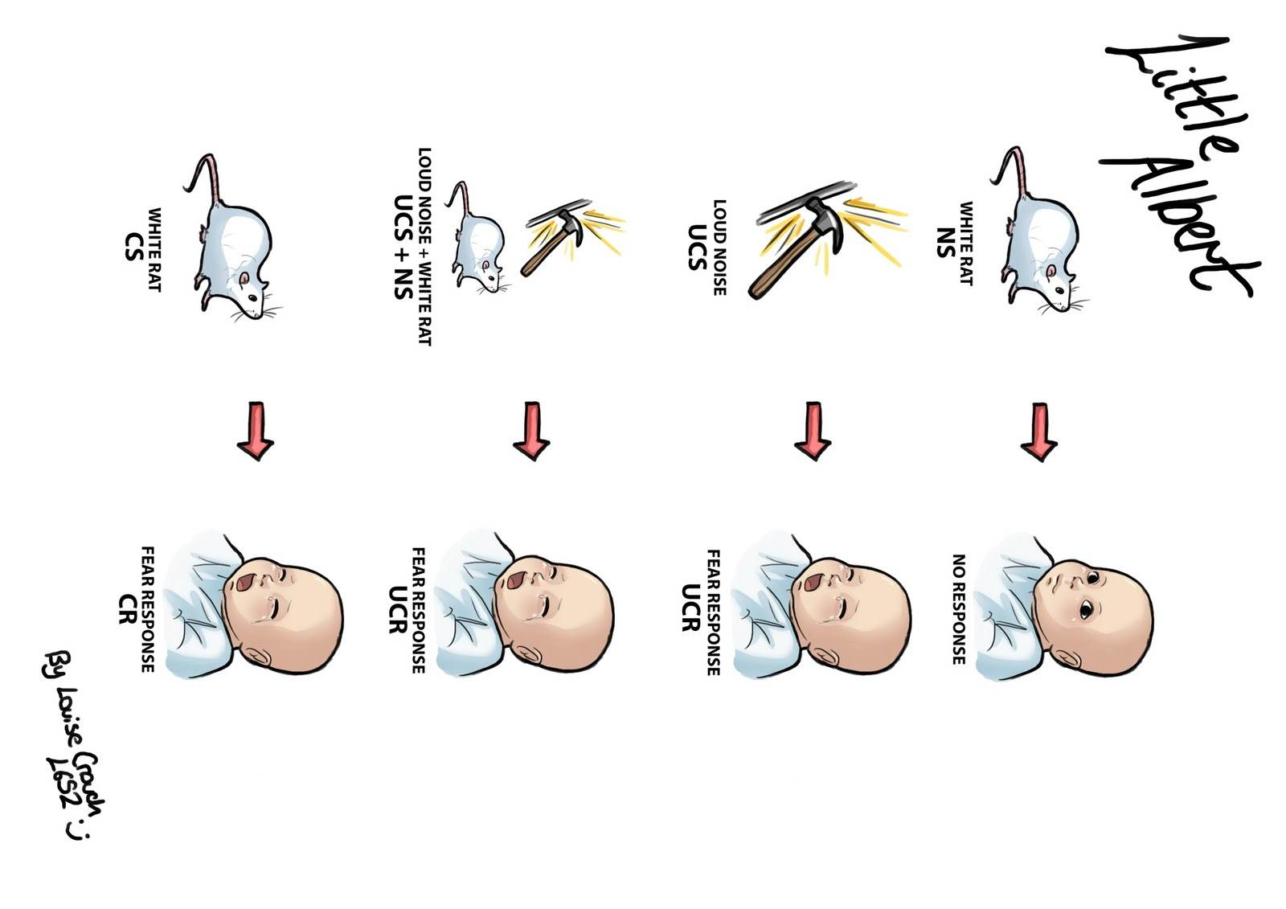

Slide 26
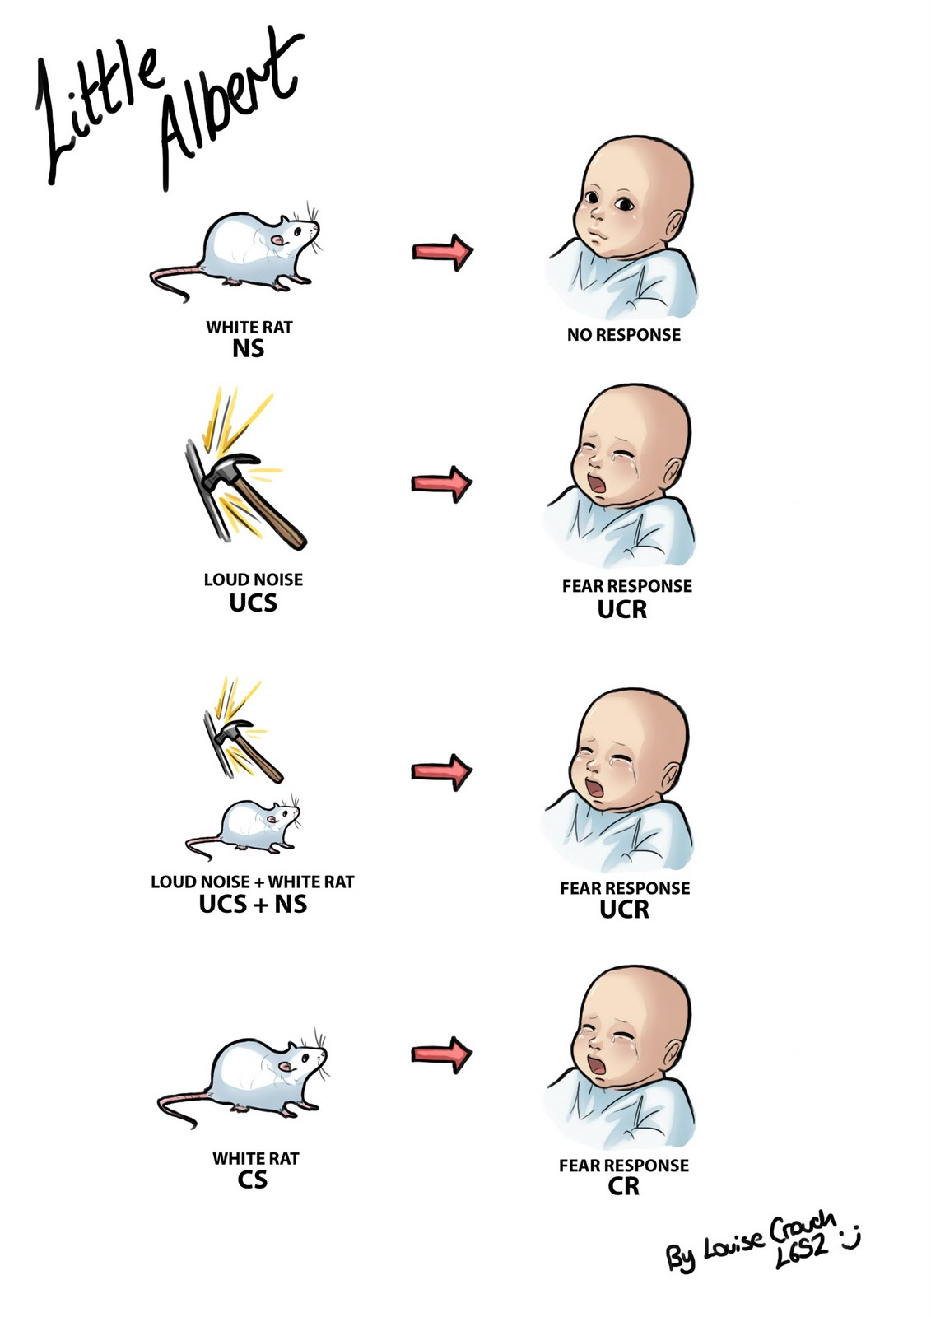


Slide 27
Evaluation of Learning Theory
Schaffer and Emerson (1964):Studied babies in Glasgow. They found that infants were not necessarily most attached to the caregiver who provided them with food and in most cases they were more attached to the person who was most responsive and who interacted with them the most.
How can this be used to support/go against Learning Theory?
What would be expect to be the findings/outcome of this study?

Slide 28
Evaluation of Learning Theory
Harlow and the Rhesus Monkeys (1959) Young monkey’s were kept on their own in cages from birth (they did not have any interactions with their biological mother). Harlow created 2 wire monkeys; one was wrapped in soft cloth but offered no food, the other offered food but offered no comfort. According to Learning Theory which wire monkey should the real monkey have been attached to?
Look at the picture on your desk, what does this suggest that Harlow found?
Does this support or go against the Learning Theory of Attachment? Explain Why?

Slide 29
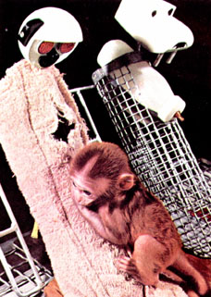
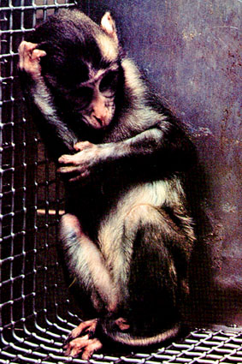

Slide 30
Evaluation of Learning Theory
This research strongly suggests that ‘cupboard love’ is unlikely to be an explanation for attachments as the monkey should have formed the attachment to the mother who provided food.

Slide 31
Evaluation of Learning Theory
Lorenz (1952) carried out research on newly hatched Greylag geese, who after seeing Lorenz shortly after hatching (their first image) followed him everywhere as he became their ‘imprinted parent.’ Lorenz explained that this suggested that newborns ‘imprint’ an image of the first moving object they see within hours after they are born which allows them to stick closely to this important source of protection.
Could this process be Classical Conditioning? Consider how quickly this process happened.
How does this information support/ go against the Learning Theory of Attachment?

Slide 32
Lesson Objectives
By the end of the lesson you will be able to...
  Define the key terms associated with Learning Theory/ Behavioural Theory of attachment.
  Outline the Behavioural Theory of attachment (Learning Theory).
  Evaluate the theory in terms of the strengths and weaknesses.
  Some students will progress on to Applying their knowledge of Learning Theory to a past exam question.

Slide 33

Plenary
Glossary Update!!
Make sure that your glossary is up to date with the terms that were presented at the end of the lesson.
Complete the note taking summary sheet to ensure that you have remembered the key information covered in today’s lesson.
Application of your knowledge to a past exam question – complete the application past exam question on the Learning Theory

Slide 34

Graffiti Wall!
Conditioned Response
Have a go at writing down some key terms linked to…
The main assumptions of the Behavioural Approach
The key principles linked to Classical Conditioning
Blank Slate
Association
Unconditioned Stimulus
Unconditioned Response
Conditioned Stimulus
Neutral Stimulus
Nurture
Environment
All behaviours learned

Slide 35


Slide 37
Evaluation of Learning Theory
Schaffer and Emerson (1964):Studied babies in Glasgow.

Slide 38
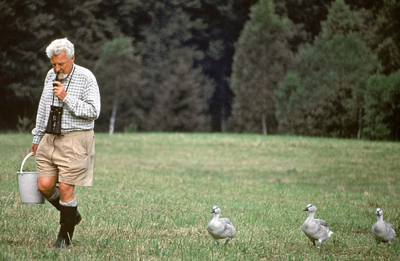

Slide 39
The Evolutionary Theory

Slide 40

The Evolutionary Theory
(Bowlby)
Infants become attached to caregiver because attachment is adaptive (good for survival)
Attachments ensure that young animals stay close to the caregiver who will feed and protect the young animal (thus aiding survival) – think about Lorenz

Slide 41
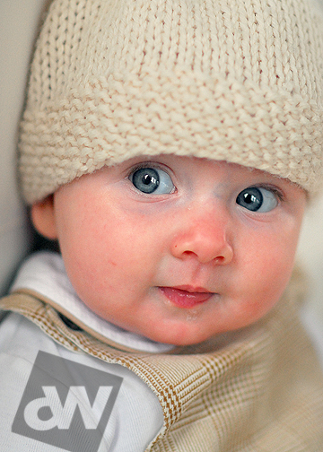
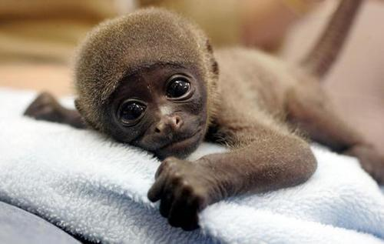
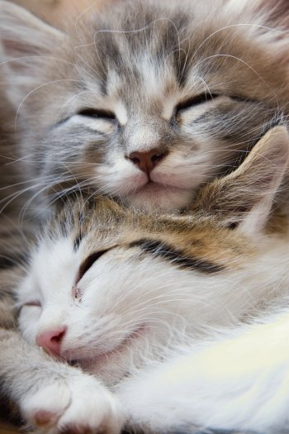

Have a look at the following pictures...

Slide 42
Answer the following questions...
  Can you think of a word to describe the images in these pictures?
  Do the babies and animals have anything in common (in terms of their physical features)? Write a few similarities down

Slide 43
The Evolutionary Theory
Infants are born with certain characteristics called ‘social releasers’
Social releasers are said to encourage care giving
Squashed up nose, big eyes, large forehead...
The drive to provide care giving is also innate as it is also adaptive (promotes survival of ones offspring and also genes).

Slide 44
Internal Working Model
Bowlby proposed the ‘Internal Working Model’ which suggests that....
  The first attachments an infant makes (usually to Mother) allows the child to view themselves as loveable or not.
  Allows the caregiver to view themselves as trustworthy or not.
  This then allows the infant to learn an attachment ‘template’ for later social relationships with other people.

Slide 45
Continuity Hypothesis
Bowlby stated that the initial template formed actually shapes future attachments with other individuals
Called the continuity hypothesis as the attachment type continues due to the template.

Slide 46

Evolutionary explanation of
Attachment: Key Terms...
Social Releasers: A social behaviour or characteristic which elicits a care giving response. Bowlby suggested these are innate and adaptive and important in the process of forming attachments e.g., smiling, crying, clinging, the “baby face” (large eyes, small nose, big forehead).
Social Releaser

Slide 47
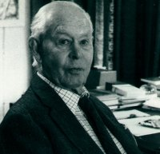
Evolutionary explanation of
Attachment: Key Terms
The Critical Period:
A time frame seen as highly important for infant development. During this period, infants develop both physically and emotionally.
Bowlby saw “Mothering” as useless for MOST children if delayed after 12 months and useless for ALL children if delayed until after 21/2 to 3 years.
The Critical Period

Slide 48
Evolutionary explanation of
Attachment: Key Terms...
Monotropy:
A single, strong, innate tendency to become attached to one particular female. This is a unique attachment and it is usually the first and strongest bond that an individual makes.
Monotropy

Slide 49

Evolutionary explanation of Attachment: Key terms...
Internal Working Model:
A template for all future relationships, including a model of how you and other people are likely to behave (we develop expectations due to our early experiences e.g., trust or mistrust).
Internal Working Model

Slide 50
Evolutionary explanation of
Attachment: Key Terms...
Continuity Hypothesis: (linked to the internal working model)
This suggests that the type of relationships people have later in their lives is influenced by their first relationships with caregivers. Many studies have supported this idea.
Emotionally secure infants therefore go on to be emotionally secure and confident adults according to this theory.
Continuity Hypothesis

Slide 51
Evaluation of Bowlby’s Theory
Point: Lorenz supports the theory because it suggests that attachment is adaptive and innate.
Explain: Young infants are born with the ability to imprint (i.e. form an attachment with a mother figure) making them more likely to survive
Evidence: The goslings in Lorenz’s study imprinted on the first moving object they saw (whether it was a goose or Lorenz himself).
Elaboration: This suggests that young animals are born with an innate readiness to create a strong bond with a mother figure.

Slide 52
Evaluation of Bowlby’s Theory
Hazen and Shaver also supported Bowlby’s theory.
They used the ‘Love Quiz’ to assess the correlation between childhood attachment type and adult attachment type.

Slide 53
The Love Quiz
Participants were asked a series of questions which looked at...
  Feelings and experiences about romantic relationships as an adult
  This was compared to a questionnaire which assessed their childhood relationships with their parents

Slide 54
Findings...
Strong correlation between childhood and adult attachment types
This supports Bowlby’s theory as it suggests that the ‘Internal Working Model’ allows infants to form an attachment template which then continues into adult attachments.

Slide 55
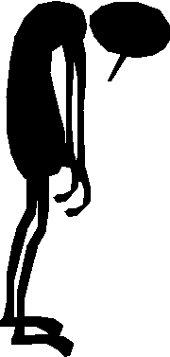
Evaluation of Bowlby’s Theory
Howes (1994) criticised Bowlby’s theory.
Howes et al found that parent-child relationships were not necessarily the same as peer-child relationships.
A child may posses more than one ‘template’ which wasn’t account for in Bowlby’s theory.

Slide 56
Evaluation of Bowlby’s Theory
The Evolutionary Theory (in particular, monotropy) is a socially sensitive idea.
Erica Burman (1994), states that Bowlby’s assumptions place a burden of responsibility on mothers, setting them up to take the blame for anything that goes wrong for the rest of the child’s life.
Also pushes mothers into certain lifestyle choices like making the decision not to return to work when a child is born.
This is a weakness because, the theory can be seen to be unethical – it’s key assumptions are seen to negatively discriminate against mothers/women.

Slide 57
EMOTIONAL
Endures over time
Two People
Two-way process
Protection
BOND

Slide 58
Graffiti Wall!

Slide 59
Learning Theory (Classical Conditioning)
Unconditioned Stimulus
Unconditioned Response
Unconditioned Stimulus
Neutral Stimulus
Unconditioned Response
Conditioned Stimulus
Conditioned Response

Slide 60
Food
Food
Comfort
Comfort
Comfort
Primary Caregiver
Primary Caregiver
Think back to unit 2 when we looked at how phobias could be learned through the process of classical conditioning (e.g. Little Albert and his phobia of white rats and fluffy toys). Have a go at placing the cards on the classical conditioning sheet in order to explain how an attachment might form (be learned between an infant and their primary caregiver (e.g. their mum).

Slide 61
Classical Conditioning

Slide 62
Evaluation of Learning Theory
Is the Learning Theory and the process of Classical Conditioning a plausible explanation of how an infant might form an attachment with their primary caregiver?
Is there any other evidence which suggests that we learning through a process of classical conditioning? Have a think for yourself and then ask your teacher for a clue ☺
If there is other evidence suggesting that we do learn through Classical Conditioning how/why would this support the Learning Theory of Attachment?

Slide 63
Think back to unit 2 when we looked at how phobias could be learned through the process of classical conditioning (e.g. little Albert and his fear of white rats and fluffy toys). Have a go at completing the classical conditioning schedule on your desk in order to explain how an attachment might form between an infant and their primary caregiver (e.g. their mum).

Slide 65
Evaluation of Learning Theory
Schaffer and Emerson (1964):Studied babies in Glasgow. They found that infants were not necessarily most attached to the caregiver who provided them with food and in most cases they were more attached to the person who was most responsive and who interacted with them the most.
How can this be used to support/go against Learning Theory?
What would be expect to be the findings/outcome of this study?

Slide 66
Evaluation of Learning Theory
Harlow and the Rhesus Monkeys (1959) Young monkey’s were kept on their own in cages from birth (they did not have any interactions with their biological mother). Harlow created 2 wire monkeys; one was wrapped in soft cloth but offered no food, the other offered food but offered no comfort. According to Learning Theory which wire monkey should the real monkey have been attached to?
Look at the picture on your desk, what does this suggest that Harlow found?
Does this support or go against the Learning Theory of Attachment? Explain Why?

Slide 68
Evaluation of Learning Theory
Lorenz (1952) carried out research on newly hatched Greylag geese, who after seeing Lorenz shortly after hatching (their first image) followed him everywhere as he became their ‘imprinted parent.’ Lorenz explained that this suggested that newborns ‘imprint’ an image of the first moving object they see within hours after they are born which allows them to stick closely to this important source of protection.
Could this process be Classical Conditioning? Consider how quickly this process happened.
How does this information support/ go against the Learning Theory of Attachment?

Slide 70
Evaluation of Learning Theory
Learning Theory can provide an adequate explanation of how attachments form.
Provides a plausible explanation as to how humans develop in response to their environment.
In real life, learn a number of things through association (danger and phobias).
This is positive as it shows that learning theory may play a least a part in attachment formation.

Slide 71
Evaluation Of Learning Theory
Schaffer and Emerson (1964):
  Studied babies in Glasgow
  Found that infants were not necessarily most attached to the caregiver who provided them with food.
  They were more attached to the person who was most responsive and who interacted with them the most.

Slide 72
Evaluation of Learning Theory
How does Schaffer and Emmerson’s study criticise Learning Theory?
  Suggests that ‘cupboard love theory’ is not likely to be the best explanation for attachments
  Seemed that attachments were not necessarily formed with the caregiver who fed them.

Slide 73
Evaluation of Learning Theory
Harlow and the Rhesus Monkeys (1959)
  Young monkey’s were kept on their own in cages
  Created 2 wire monkeys; one was wrapped in soft cloth but offered no food
  The other offered food but offered no comfort
  According to Learning Theory which wire monkey should the real monkey have been attached to?

Slide 74
Problems with Harlow’s Research?

Slide 75
Evaluation of Learning Theory
Attachments are innate.
-Lorenz (1952) suggests that newborns ‘imprint’ an image of their parents within hours of being born.
This allows the infant to stick closely to this important source of protection and food.
This criticises Learning Theory as it suggests that attachment is innate because the infants are far too young to have learned anything at this age.

Slide 76
1

Slide 77
2

Slide 78
3

Slide 79
4

Slide 80
Learning Theory/Behavioural Theory of Attachment
Evolutionary Theory of Attachment
Biological Explanation
Learning Explanation
Nature (behaviours are a product of our biology)
Nurture (behaviours determined by environment/upbringing/experiences
Develop attachment through association/classical conditioning
Individuals have a gene that motivates attachments to form
Food is important in attachment formation – infants learn to associate their primary caregiver as the provider of food
Caregivers are genetically programmed to form attachments with their offspring

Slide 81
Attachments form in order to accommodate gene survival
Infants find food comforting (pleasurable) and therefore infants begin to associate their primary caregiver as a provider of comfort
Infants are able to encourage the attachment formation process due to them exhibiting social releasers (features that make infants look cute/vulnerable).
Also referred to as the ‘Cupboard Love Theory’

Slide 82
Evolutionary Theory Key Terms
A social behaviour or characteristic which elicits a care giving response. Bowlby suggested these are innate and adaptive and important in the process of forming attachments e.g., smiling, crying, clinging, the “baby face” (large eyes, small nose, big forehead).
A template for all future relationships, including a model of how you and other people are likely to behave (we develop expectations due to our early experiences e.g., trust or mistrust).
A time frame seen as highly important for infant development. During this period, infants develop both physically and emotionally.
Bowlby saw “Mothering” as useless for MOST children if delayed after 12 months and useless for ALL children if delayed until after 21/2 to 3 years.
This suggests that the type of relationships people have later in their lives is influenced by their first relationships with caregivers. Many studies have supported this idea.
Emotionally secure infants therefore go on to be emotionally secure and confident adults according to this theory.
A single, strong, innate tendency to become attached to one particular female. This is a unique attachment and it is usually the first and strongest bond that an individual makes.

