Slide 1
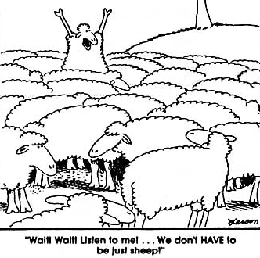
Resisting conformity
Social support
Locus of control
For what reasons were some participants able to not conform in Asch’s research?

Slide 2
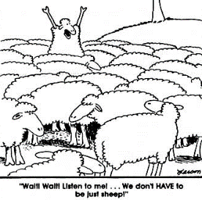
Social support
A01
…get by with a little help from my friends…
Conformity is most powerful when the group are unanimous (all in agreement).
When someone goes against the crowd (a dissenter) they provide the participant with moral support

Slide 3
Social support
A01
The dissenter makes independence an option for the participant
Where did we see this in Asch’s research?
When the participant had a dissenter conformity rates dropped from 37% to 5%

Slide 5
Social support
A03
Allen & Levine – replicated Asch’s research with some variations
They found that there was a significant drop in conformity in conditions 1 & 2.
Condition 1 | A dissenter with extremely poor vision (evident from glasses being worn) was present
Condition 2 | A dissenter with normal vision was present
Condition 3 | No dissenter present

Slide 6
Who’s to blame?
A student forgets their football kit for an important match
A man ‘snoozes’ his alarm and is late for work
A student doesn’t do as well as expected in an exam
A student misses their bus because their teacher kept them behind after lesson

Slide 7
Complete the Locus of Control questionnaire

Slide 8
Locus of Control – Rotter 1966
The extent to which an individual feels they are in control of their own behaviour
Ranges from ‘Internal’ to ‘External’
Internals take personal responsibility for their behaviour
Externals believe they’re controlled by luck and fate
A01

Slide 10
Internal Vs. External
Internal Locus of Control
Self
Great deal of personal control
External Locus of Control
Others
Behaviour controlled by others/fate/luck
Take responsibility
“I made it happen”
Failed an exam because I didn’t revise
Avoid responsibility
“I was in the wrong place at the wrong time”
Failed an exam because the exam board didn’t ask the right questions

Slide 11
Who is more likely to obey?
INTERNAL
- Likely to display independent behaviour
EXTERNAL
- Likely to obey
Think about the characteristics of someone with a ‘high internal’ and another with a ‘high external’ Locus of Control
Which is more likely to obey and which is more likely to display independent behaviour?

Slide 12
A03
Schute (1975) exposed undergraduates to peers who expressed either conservative or liberal attitudes to drug taking and found that undergraduates with an internal LoC conformed less to expressing pro-drug attitudes.

Slide 13
A03
Atgis (1998) carried out meta-analysis of studies looking at the relationship between locus of control and conformity. He found a positive correlation (0.37) between external locus of control and persuasion

Slide 14
A03
Elms & Milgram (1974) set out to investigate the background of disobedient participants by following up and interviewing a sub-sample of those involved in Milgram’s experiments. Milgram found that disobedient participants had an internal locus of control

Slide 15
A03
Schurz (1985) found no relationship between LoC and obedience among Austrian participants who gave the highest level of what they believed to be painful, skin-damaging bursts of ultrasound to a learner.

