Slide 1
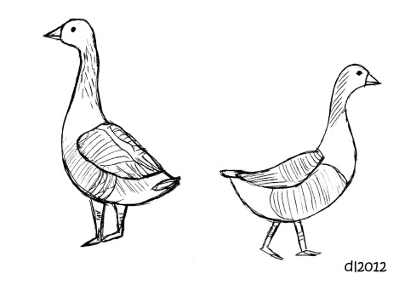
Animal Research and Attachment

Slide 2
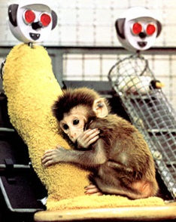
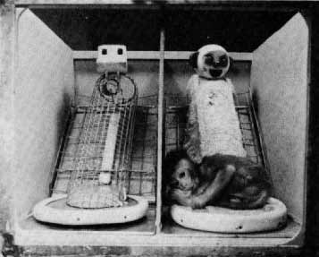
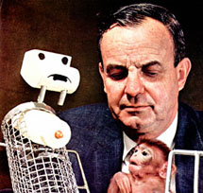
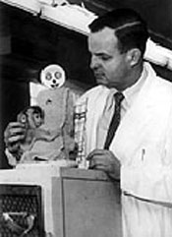
Harlow’s Research
Aim
Procedure:
__ types of surrogate mothers were used.
A harsh ___ monkey and a monkey with a ____ towelling fabric.
___ baby rhesus monkeys were used.
___ in each condition
Condition 1
Condition 2
Condition 3
Condition 4
The amount of _____ spent with each ________ was recorded. The monkeys were also tested with _____ _____ to see which mother they would cling to during times of stress.
Findings
Monkeys preferred contact with __________________________ regardless of ___________________________
The monkeys even _______________________________________ whilst still clinging to the _________________
Monkeys with only the _____ ____________ suffered from diarrhoea ( a sign of _________)
When frightened by a loud noise, monkeys clung to the ______________ mother (when available)
In the larger cage conditions, monkeys with the ________________ mother explored more and visited the surrogate more.
Conclusion
Rhesus monkeys have an _____, unlearned need for contact and comfort suggesting that attachment concerns _________ security more than ______. Contact comfort is associated with lower levels of _______ and a willingness to ________, indicating emotional ___________

Slide 3
Harlow’s Research
Aim
Procedure:
__ types of surrogate mothers were used.
A harsh ___ monkey and a monkey with a ____ towelling fabric.
___ baby rhesus monkeys were used.
___ in each condition
To test the Learning Theory to see if infants prefer comfort or food
Condition 1
Condition 2
Condition 3
Condition 4
The amount of _____ spent with each ________ was recorded. The monkeys were also tested with _____ _____ to see which mother they would cling to during times of stress.
Wire monkey - milk
Wire monkey – milk, cloth monkey no milk
Wire monkey- no milk, cloth monkey- milk
Soft monkey - milk
Findings
Monkeys preferred contact with __________________________ regardless of ___________________________
The monkeys even _______________________________________ whilst still clinging to the _________________
Monkeys with only the _____ ____________ suffered from diarrhoea ( a sign of _________)
When frightened by a loud noise, monkeys clung to the ______________ mother (when available)
In the larger cage conditions, monkeys with the ________________ mother explored more and visited the surrogate more.
Conclusion
Rhesus monkeys have an _____, unlearned need for contact and comfort suggesting that attachment concerns _________ security more than ______. Contact comfort is associated with lower levels of _______ and a willingness to ________, indicating emotional ___________

Slide 4
Harlow’s Research Evaluation
(1) A strength is that this research was conducted in a lab… what elements of this study could be controlled to ensure that the researchers could establish cause and effect?
(2) A weakness of this study is that it was conducted in an artificial setting… give an example as to why is this a problem. Do animals and humans act normally when they are being observed in controlled settings?
(3) This study can be seen to be unethical… give an example why? Would the animals be able to live a normal life after this study? Where there any long lasting effects?

Slide 5
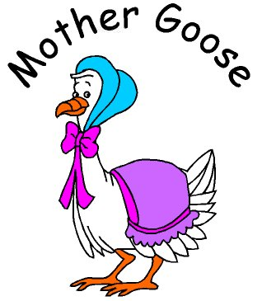
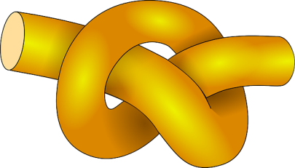
Lorenz’s Research

Slide 6
Lorenz - Evaluation
Lorenz’s findings have been highly influential within the field of developmental psychology.
For example, the fact that imprinting is seen to be irreversible suggests that attachment formation is under biological control

