Slide 1
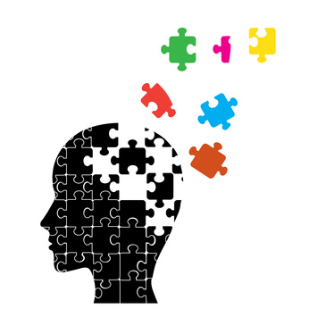
Forgetting
Lesson Objectives:
By the end of the lesson you will be able to…
Be able to define the terms ‘forgetting’, ‘proactive’ and ‘retroactive’ inference
Describe and evaluate research into retroactive inference
Describe and evaluate ‘cue dependent forgetting.’
Describe and evaluate ‘state dependent failure.’

Slide 2
Forgetting
The failure to retrieve memories (retrieval failure), with explanations focusing on the idea that we may not be able to remember a memory because…
It is no longer in the memory store
(b) We have issues retrieving the memory.

Slide 3
The Multi-Store model of memory states that LTM has an unlimited capacity, and memories have a duration of potentially a lifetime.
However, we know by experience that we forget information stored in the LTM.
But does that mean the memories are gone (availability), or we just can’t reach them (accessibility) ?

Slide 4
Forgetting: Interference
Interference: one memory disturbs the ability to recall another. This might result in forgetting or distorting one or the other or both. This is more likely to happen if the memories are similar.
Retroactive interference:
This occurs when coding new information disrupts information stored previously (new prevents old)
For example: the memory of your new car registration number prevents recall of your previous car registration number.
Proactive interference:
This occurs when information stored previously interferes with an attempt to recall something new (old prevents new)
For example: a memory of your old mobile number disrupts attempts to recall your new mobile number.
Old memory
New memory
Old memory
New memory
Proactive interference
Pro=forward
Retroactive interference
Retro=backward

Slide 5
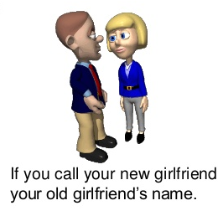
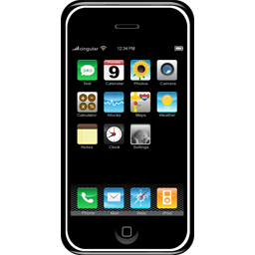
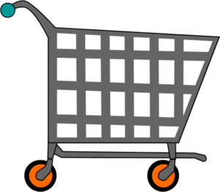
Proactive interference or Retroactive interference?
Proactive
A teacher has an inability to remember the names of the students that he used to teach last because he has remembered a new class of names.
Retroactive
Your new mobile number preventing you from being able to remember your old mobile number.
Retroactive
Remembering items on a shopping list from last week but not being able to remember the items on a shopping list for this week.
An inability to remember your old postcode because you have remembered the one belonging to your new house.
Retroactive
Proactive

Slide 6
Let’s give forgetting a go!!

Slide 7
Underwood & Postman(1960)
Aim: to find out if new learning interferes with previous learning.
Procedure: Participants were divided into two groups. Group A were asked to learn a list of word pairs i.e. cat-tree, they were then asked to learn a second list of word pairs where the second paired word was different i.e. cat – glass. Group B were asked to learn the first list of word pairs only. Both groups were asked to recall the first list of word pairs.
Results: Group B recall of the first list was more accurate than the recall of group A.
Conclusion: This suggests that learning items in the second list interfered with participants’ ability to recall the list. This is an example of retroactive interference.

Slide 9
To assess the influence of retroactive interference upon the memory of street names learned during childhood
(1) 700 names were randomly selected from a database of 1700 former students at a Deutsch elementary school.
(2)Participants were sent a questionnaire to complete.
(3) 211 participants responded, ranging in age from11 to 79 years old.
(4) As part of the questionnaire, participants were given a map of the Molenberg neighbourhood (where they had gone to school) with all 48 street names replaced with numbers.
(5) Participants were asked to remember as many of the street names as possible.
(6) Other personal details collected included; how many times they had moved house, where they had lived and for how long, how often they had visited Molenberg.
(7) The amount of retroactive interference experienced was assessed by the number of times the individual had moved to another neighbourhood or city (thus learning new sets of street names).

Slide 10
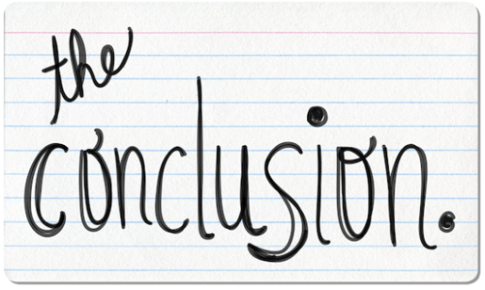
There was a positive association between the number of times participants had moved house outside the Molenberg neighbourhood and the number of street names they had forgotten.
The findings suggested that learning new patterns of street names when moving house makes remembering old patterns of street names harder to do.
Retroactive interference does seem able to explain forgetting in some real-life situations.

Slide 11
Lab Research from Underwood and Postman
Support for the interference theory comes from Underwood and Postman’s research illustrating that new learning can interfere with previous learning.
Participants were divided into two groups. Group A were asked to learn a list of word pairs i.e. cat-tree, they were then asked to learn a second list of word pairs where the second paired word was different i.e. cat – glass. Group B were asked to learn the first list of word pairs only. Both groups were asked to recall the first list of word pairs. Underwood and Postman found that Group B recall of the first list was more accurate than the recall of group A.
This is a strength because the research suggests that learning items in the second list interfered with participants’ ability to recall the list and therefore supports the existence of retroactive interference.

Slide 12
Lab Research - Artificial
However, a weakness of the interference theory is that it is most commonly tested using laboratory experiments
For example, participants are often to complete artificial tasks such s learning a list of words which lacks mundane realism and can result in participants displaying artificial behaviours.
This is a weakness because it means that any results from the lab experiments cannot be generalised to real-life forgetting which weakens those experiments as support of interference theory.

Slide 13
A Real-Life Study: Baddeley & Hitch (1977)
Support for the interference theory comes from Baddeley and Hitch who compared interference to trace decay as an explanation for forgetting.
Asked rugby players to recall the names of teams recently played. For various reasons including injuries and suspensions most players they interviewed had missed some games, so for one player the last game might have been last week, while for another it was two months ago. Baddeley and Hitch found that recall for the last game was equally good whether that game was played some time ago or last week. This shows that incorrect recall was not due to decay (the passage of time) but was related to the number of intervening games.
This is a strength because of demonstrates that forgetting is more likely to be due to information in the LTM becoming confused, supporting the interference theory.

Slide 14
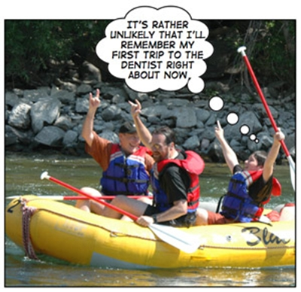
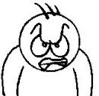
Cue-dependent forgetting
This theory explains forgetting in the LTM as a retrieval failure: the information is stored in the LTM but cannot be accessed.
Forgetting according to this theory is due to lack of cues.
Two types of cues:
Cues which are linked meaningfully to the information to be remembered.
Cues which are not linked meaningfully to the information to be remembered.
This theory proposes that when we learn the information we also encode the context (external cues) in which we learn the information and the mental state we are in (internal cues). These can act as cues to recall.
Context dependent forgetting
State-dependent forgetting

Slide 15
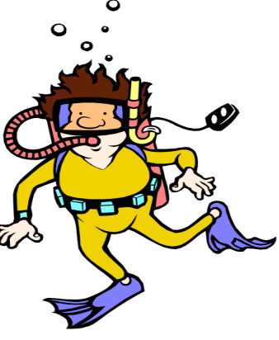
Context-dependent forgetting
Context-dependent forgetting can occur when the environment during recall is different from the environment you were in when you were learning.
Aim: Godden and Baddeley (1975) investigated the effect of environment on recall.
This study took place in Scotland.
Procedure:
18 divers from a diving club were asked to learn lists of 36 unrelated words of two or three syllables
4 conditions :
Learn on beach recall on beach
Learn on beach recall under water
Learn under water recall on beach
Learn under water recall under water
Results
Conclusion: the results show that the context acted as a cue to recall as the participants recalled more words when they learnt and recalled the words in the same environment than when they learnt and recalled the words in different environments.

Slide 16
Evaluation – Context Dependent Failure
There is further support for the influence of contextual cues. Abernathy (1940) found that students performed better in tests if the tests took place in the same room as the learning of the material had taken place, and were administered by the same instructor who had taught the information.
The environment was familiar to the divers but the task was artificial as we are not usually asked to learn a list of meaningless words in our everyday life.
High Control!

Slide 17
State-dependent forgetting
State-dependent forgetting occurs when your mood or physiological state during recall is different from the mood you were in when you were learning.
Goodwin et al. (1969). Forty-eight male medical students participated on day 1 in a training session and on day 2 in a testing. They were randomly assigned to four groups.
Group1: (SS) was sober on both days.
Group 2: (AA) was intoxicated both days.
Group 3: (AS) was intoxicated on day 1 and sober on day 2.
Group 4: (SA) was sober on day 1 and intoxicated on day 2.
The intoxicated groups had 111 mg/100 ml alcohol in their blood .They all showed signs of intoxication.
The Participants had to perform 4 tests: an avoidance task, a verbal rote-learning task, a word-association test, and a picture recognition task.
Results:
More errors were made on day 2 in the AS and SA condition than in the AA or SS conditions, however this was not the case for the picture recognition test. The SS participants performed best in all tasks.
Conclusion: this supports the state-dependent memory theory as the performance was best in the participants who were sober or intoxicated on both days.

Slide 18
Evaluation – State Dependent Failure
This study has limited ecological validity because the tasks performed by the participants were artificial therefore their performance might not reflect the way they would perform on tasks in every day life.
There is further support for the influence of state-dependent cues. Overton (1964) experimented on two groups of rats, one group was given a mild barbiturate the other group did not get the drug. They were then placed in a simple maze and taught to escape an electrical shock. When the group with the drug were placed back in the maze without the drug they could not remember how to escape the shock but if they were given the drug again they could recall how to escape the shocks.
The participants know that they were taking part in a study so they might have changed their behaviour (demand characteristics) to fit in with the aims of the study.
However it was a controlled experiment so it can be replicated so reliability can be tested.

Slide 19
Real Life Application
Real –life applications:
This is used as a strategy to improve recall in eye-witness memory when the witnesses are asked to describe their mood/ emotional state when the incident they have witnessed took place (cognitive interview).

Slide 20
Evaluation – Context Dependent Failure
This study has limited ecological validity because the environment was familiar to the divers but the task was artificial as we are not usually asked to learn a list of meaningless words in our everyday life.
Another weakness is that the groups who learnt and recalled in different environments were disrupted (they had to change environment) whereas the groups who learnt and recalled in the same environment were not disrupted. This could have influenced their recall.
However it was a controlled experiment so it can be replicated so reliability can be tested.
There is further support for the influence of contextual cues. Abernathy (1940) found that students performed better in tests if the tests took place in the same room as the learning of the material had taken place, and were administered by the same instructor who had taught the information.
The studies carried out do not take into account the meaning of the material and the level of motivation of the person when learning the information.
Real –life applications:
This is used as a strategy to improve recall in eye-witness memory when the witnesses are asked to describe the context in which the incident they have witnessed took place during cognitive interviews.
This theory is difficult to disprove as if recall does not occur is it because the information is not stored or because you are not providing the right cue? (circular argument)

Slide 21
Evaluation – State Dependent Failure
This study has limited ecological validity because the tasks performed by the participants were artificial therefore their performance might not reflect the way they would perform on tasks in every day life.
The participants know that they were taking part in a study so they might have changed their behaviour (demand characteristics) to fit in with the aims of the study.
However it was a controlled experiment so it can be replicated so reliability can be tested.
There is further support for the influence of state-dependent cues. Overton (1964) experimented on two groups of rats, one group was given a mild barbiturate the other group did not get the drug. They were then placed in a simple maze and taught to escape an electrical shock. When the group with the drug were placed back in the maze without the drug they could not remember how to escape the shock but if they were given the drug again they could recall how to escape the shocks.
The studies carried out do not take into account the meaning of the material and the level of motivation of the person when learning the information. However a strength is that animals are not influenced by demand characteristics.
Real –life applications:
This is used as a strategy to improve recall in eye-witness memory when the witnesses are asked to describe their mood/ emotional state when the incident they have witnessed took place (cognitive interview).
This theory is difficult to disprove as if recall does not occur is it because the information is not stored or because you are not providing the right cue? (circular argument)

